Slide 1
PLANIFY- TASK REMAINDER WEBSITE
BY
R.NAMRATHA - 22N31A12F2

Slide 2
AGENDA
Introduction
System Requirements
Application Description
Source Code
Results

Slide 3

INTRODUCTION
Planify - Task Reminder is a smart and efficient task management application designed to help users stay organized and productive. Whether it’s an urgent task, a long-term goal, or a personal commitment, Planify ensures that you never miss an important deadline. With features like emergency task prioritization, categorized task input, and an organized task list, users can seamlessly manage their daily activities. The application also includes progress tracking, calendar integration, and a chatbox for collaboration, making it an all-in-one productivity tool. Planify simplifies task management, helping users focus on what truly matters while staying on top of their schedules.

Slide 4

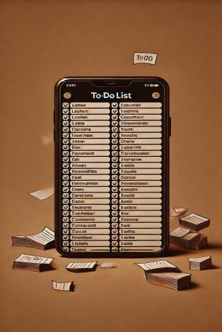
EXISTING SYSTEM
/
In traditional task management, people often rely on manual methods such as paper planners, sticky notes, or basic to-do lists on their phones. These methods lack efficiency, reminders, and proper categorization, making it easy to forget important tasks. Some digital applications provide task management features, but they may not prioritize urgent tasks, offer effective categorization, or provide real-time tracking. Additionally, collaboration and progress monitoring are often limited, making it difficult for users to stay consistently organized.
.

Slide 5


PROPOSED SYSTEM
Planify offers a structured and efficient way to manage tasks by integrating automated reminders, task categorization, and progress tracking in a single platform. It allows users to prioritize emergency tasks, classify tasks as short-term or long-term, and view them in an organized manner. With features like calendar integration, chatbox support, and a dedicated dashboard, Planify ensures seamless task management. The system enhances productivity by reducing the chances of missing deadlines while providing a user-friendly interface for easy navigation and task organization.

Slide 6
SOFTWARE REQUIREMENTS
Frontend: HTML, CSS, JavaScript
Backend: Node.js
Database: MongoDB
Development Tools: VS Code
Notification Services -
Email Notifications: Nodemailer
Browser Notifications: JavaScript Notification API

Slide 7
HARDWARE REQUIREMENTS
Processor: Intel i3 or higher (or equivalent AMD)
RAM: Minimum 4GB (8GB recommended)
Storage: Minimum 20GB free space

Slide 8
APPLICATION DESCRIPTION
Planify is a task reminder application designed to help users manage their tasks efficiently. It allows users to create, update, and delete tasks with categorized reminders. The application ensures timely task completion by sending SMS or email notifications. Emergency tasks are displayed separately with a visually distinct layout.
User Management (Authentication, Profile , FAQ)
Task Management (Create, Delete, Categorization, Emergency Handling)
Reminder System (Notifications, Alerts)
User Engagement (Reviews, AI Bot)
Visualization & Tracking (Dashboard, Calendar , Progress Tracking)

Slide 9
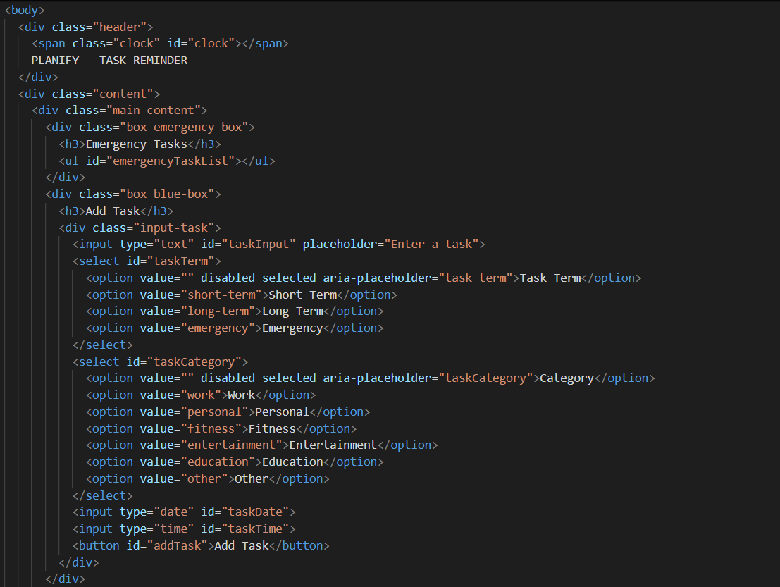
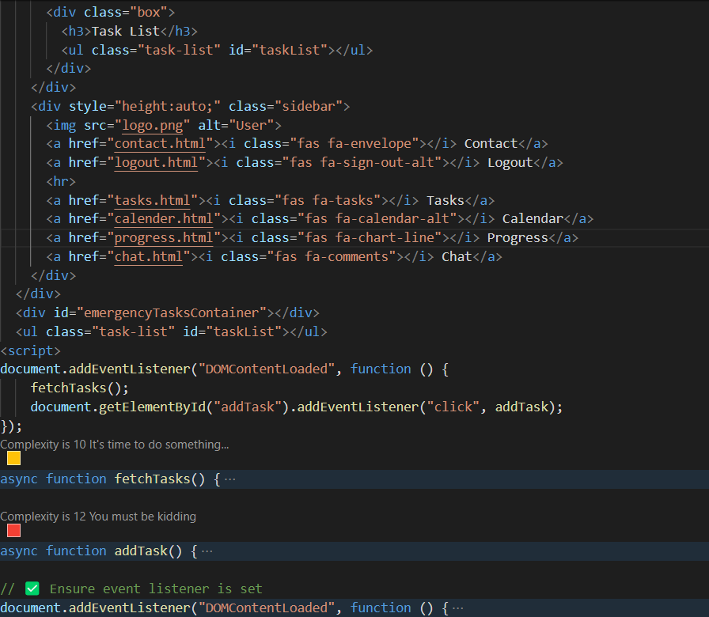
SOURCE CODE

Slide 10
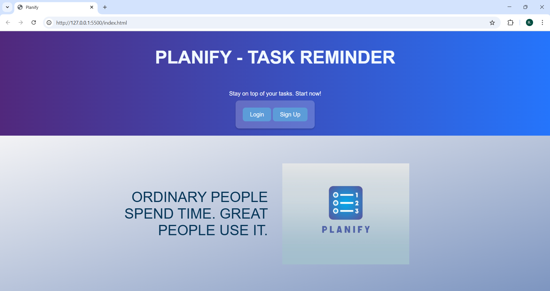
RESULTS

Slide 11
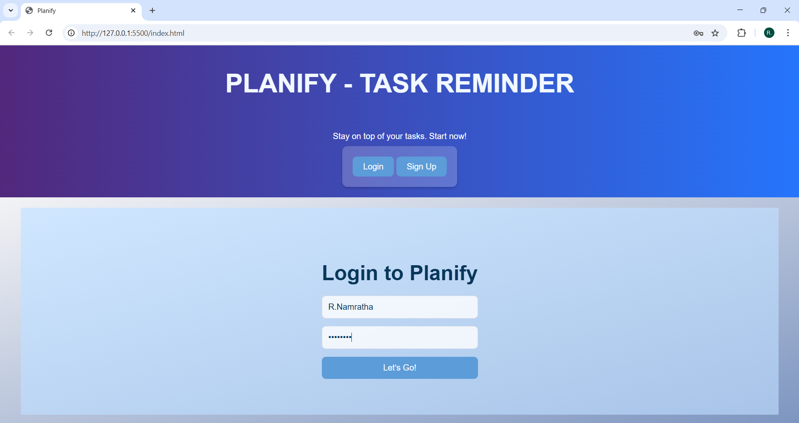

Slide 12
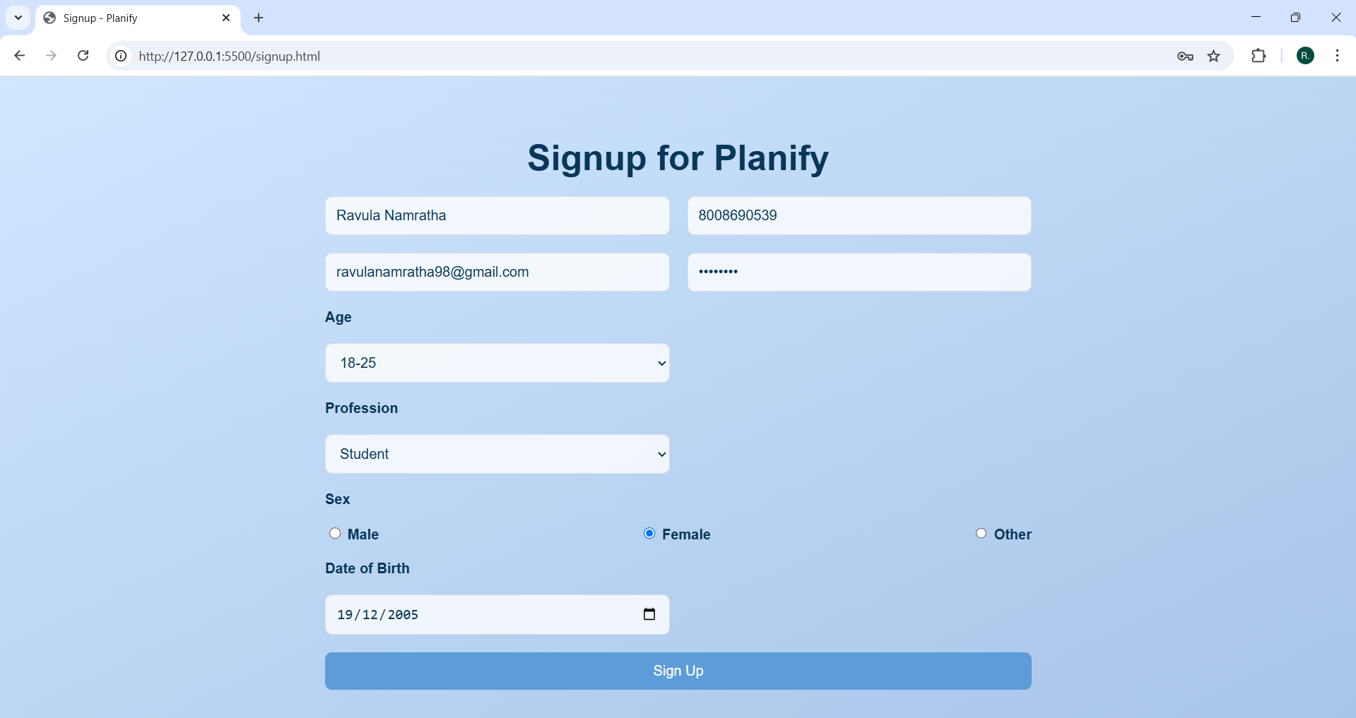

Slide 13
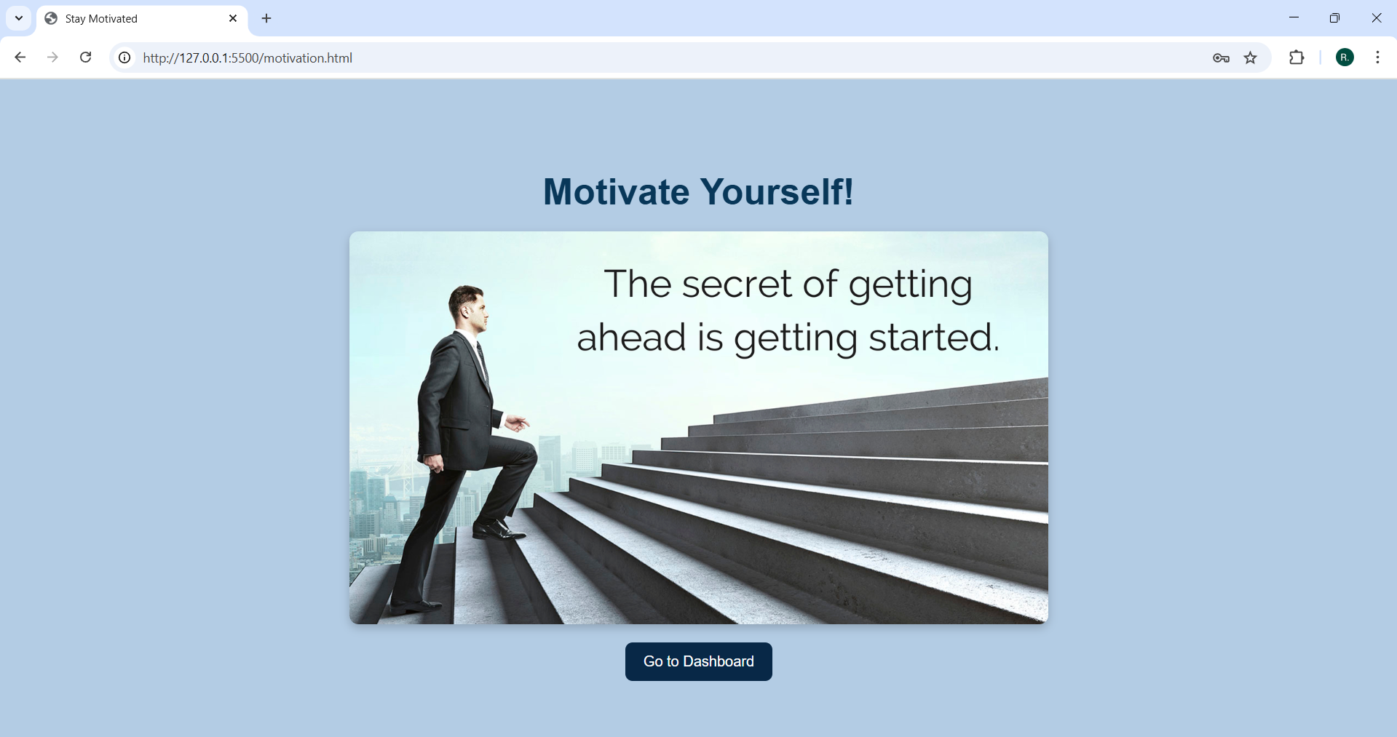

Slide 14
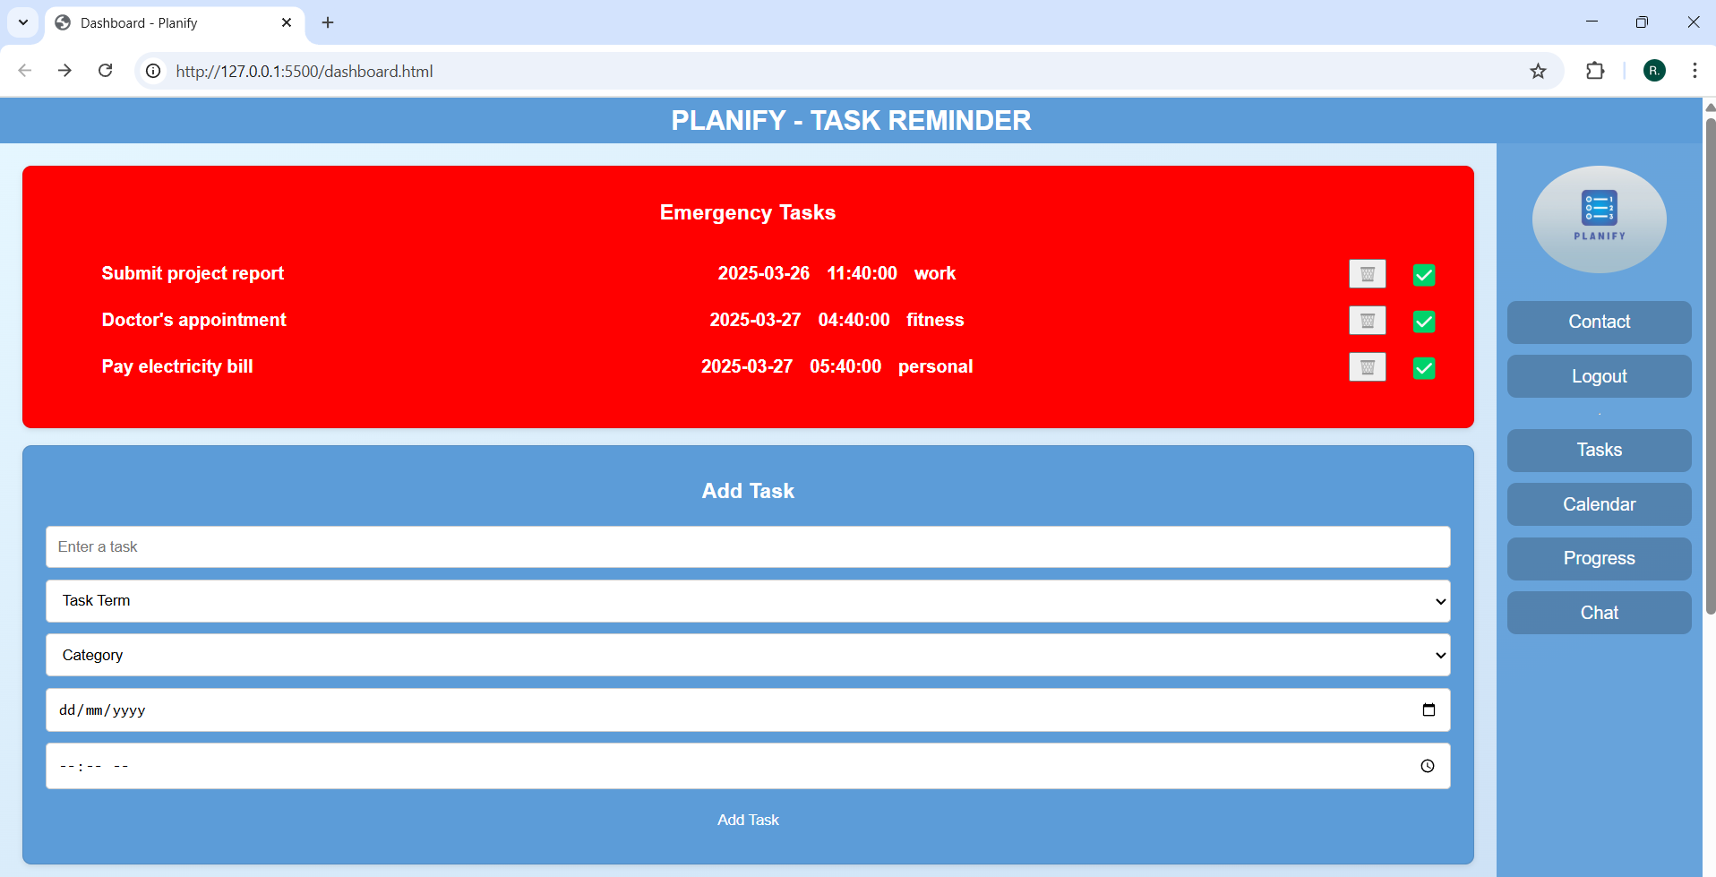

Slide 15
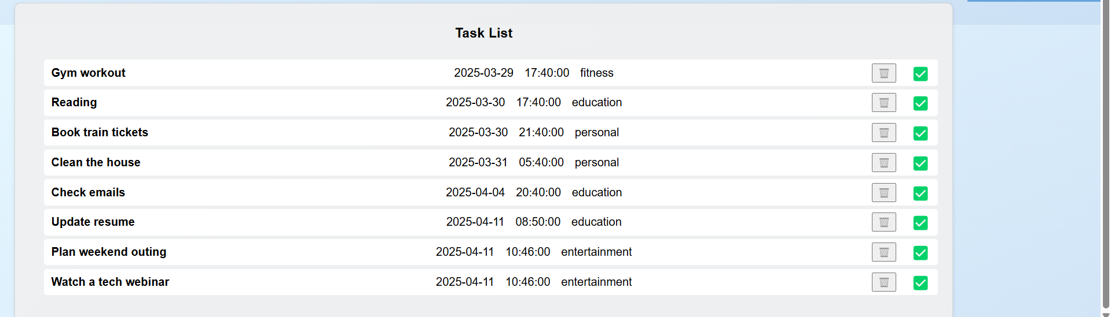

Slide 16
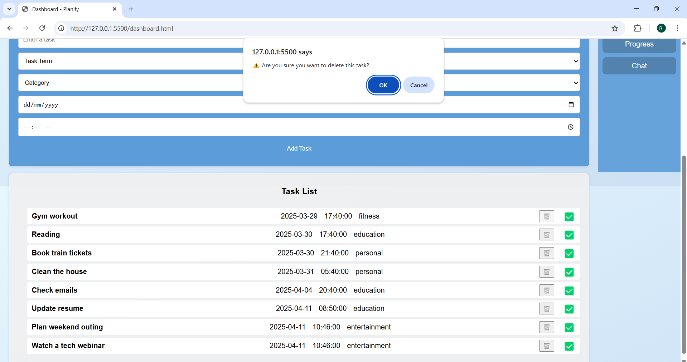

Slide 17
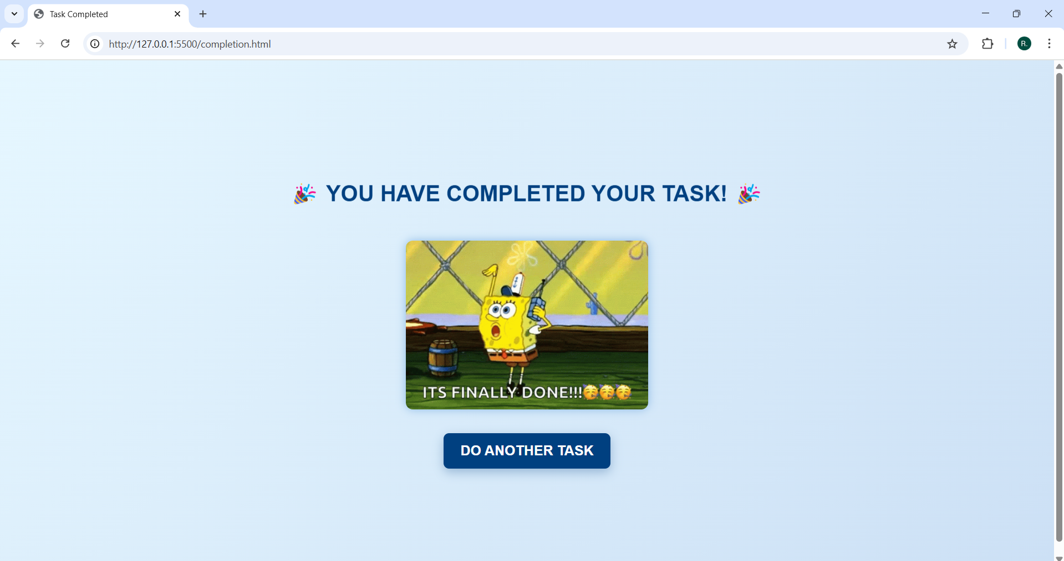

Slide 18
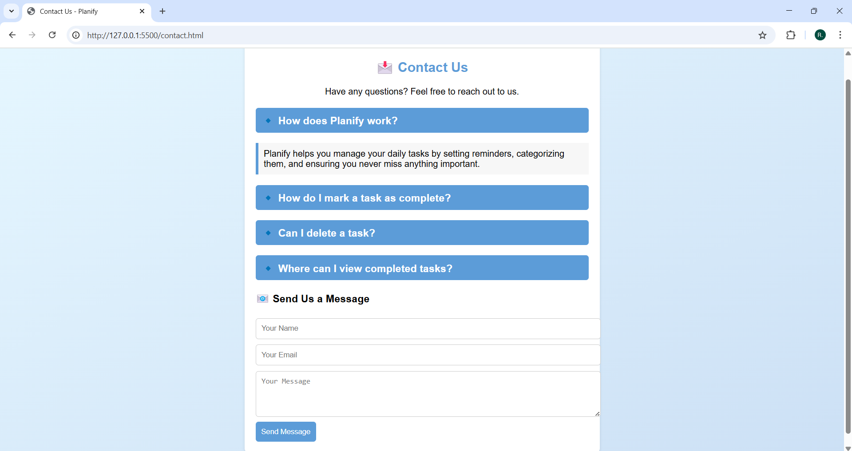

Slide 19
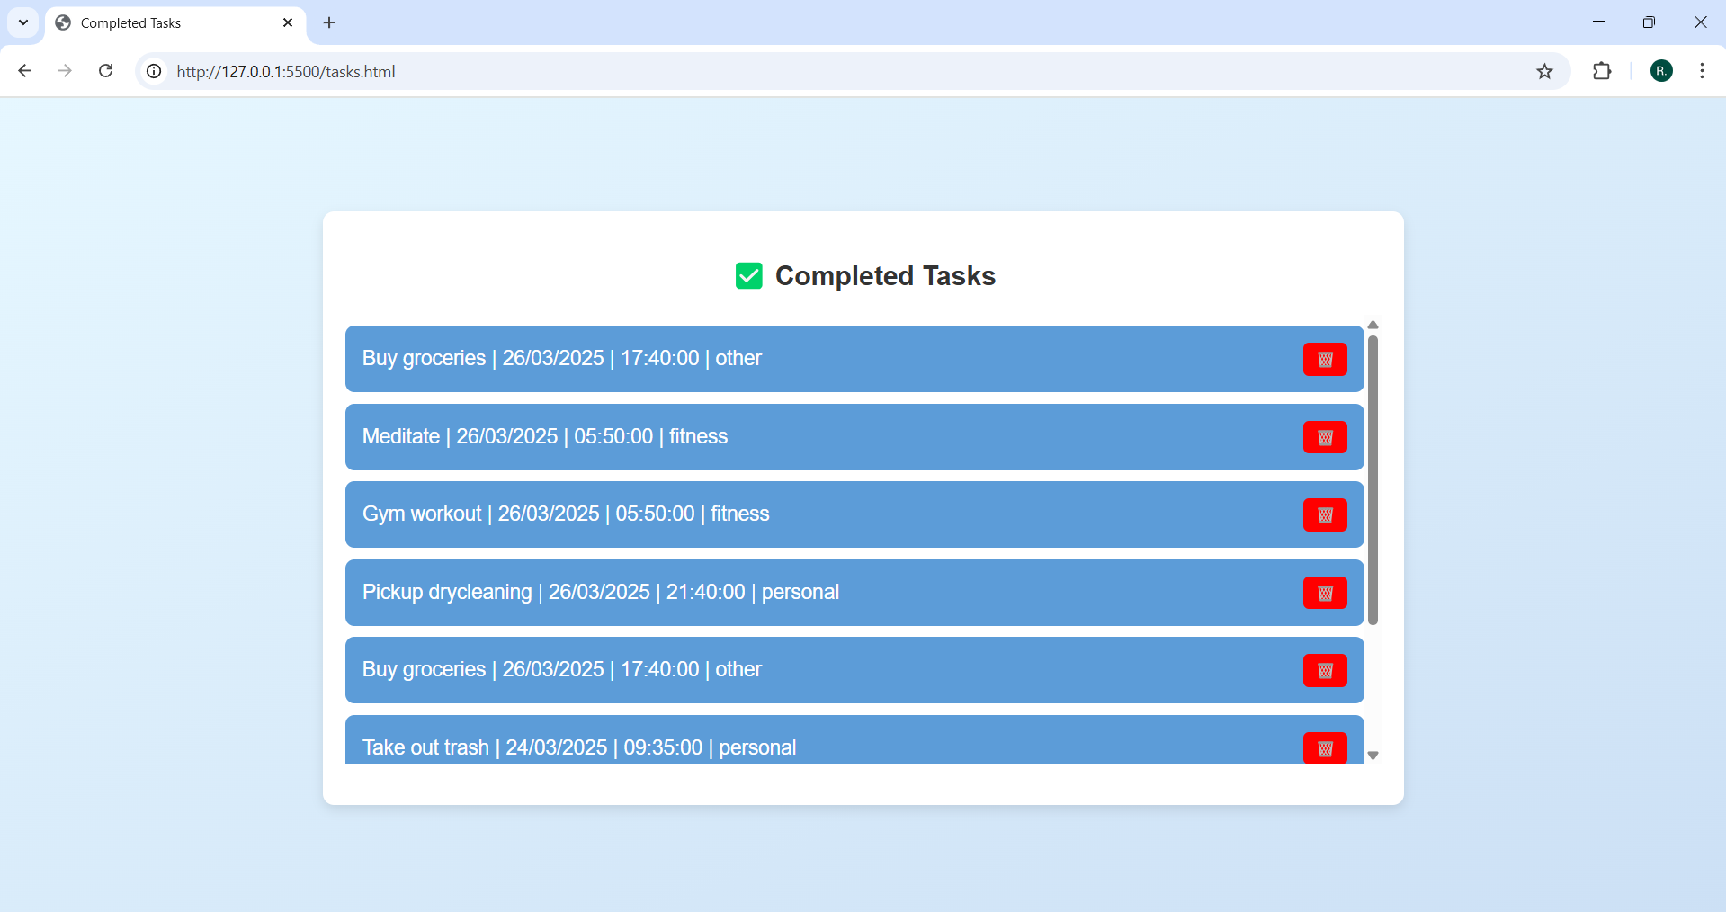

Slide 20
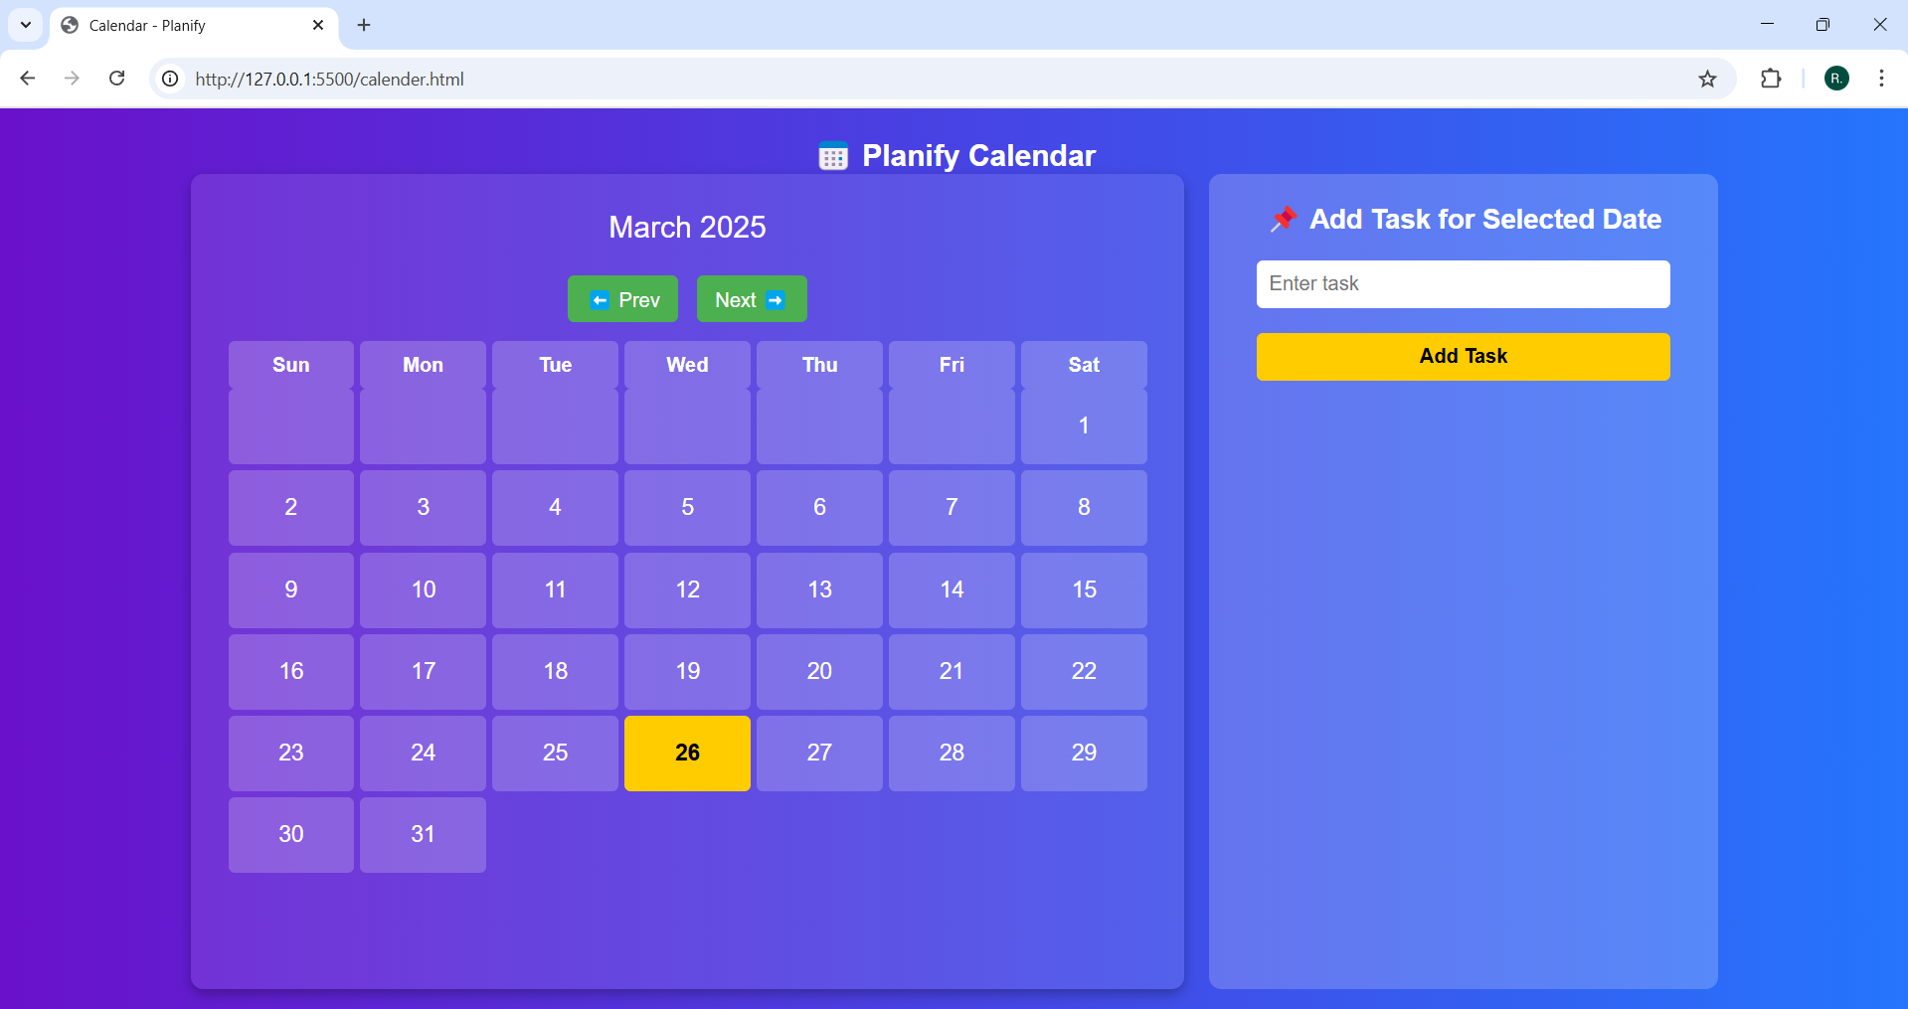

Slide 21
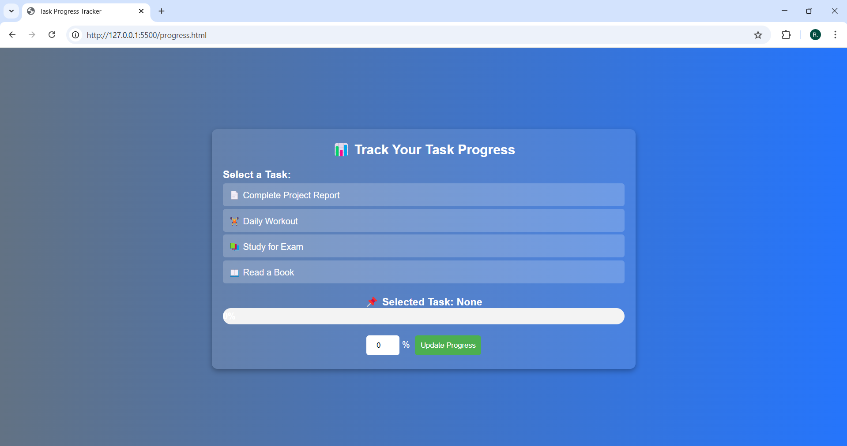

Slide 22
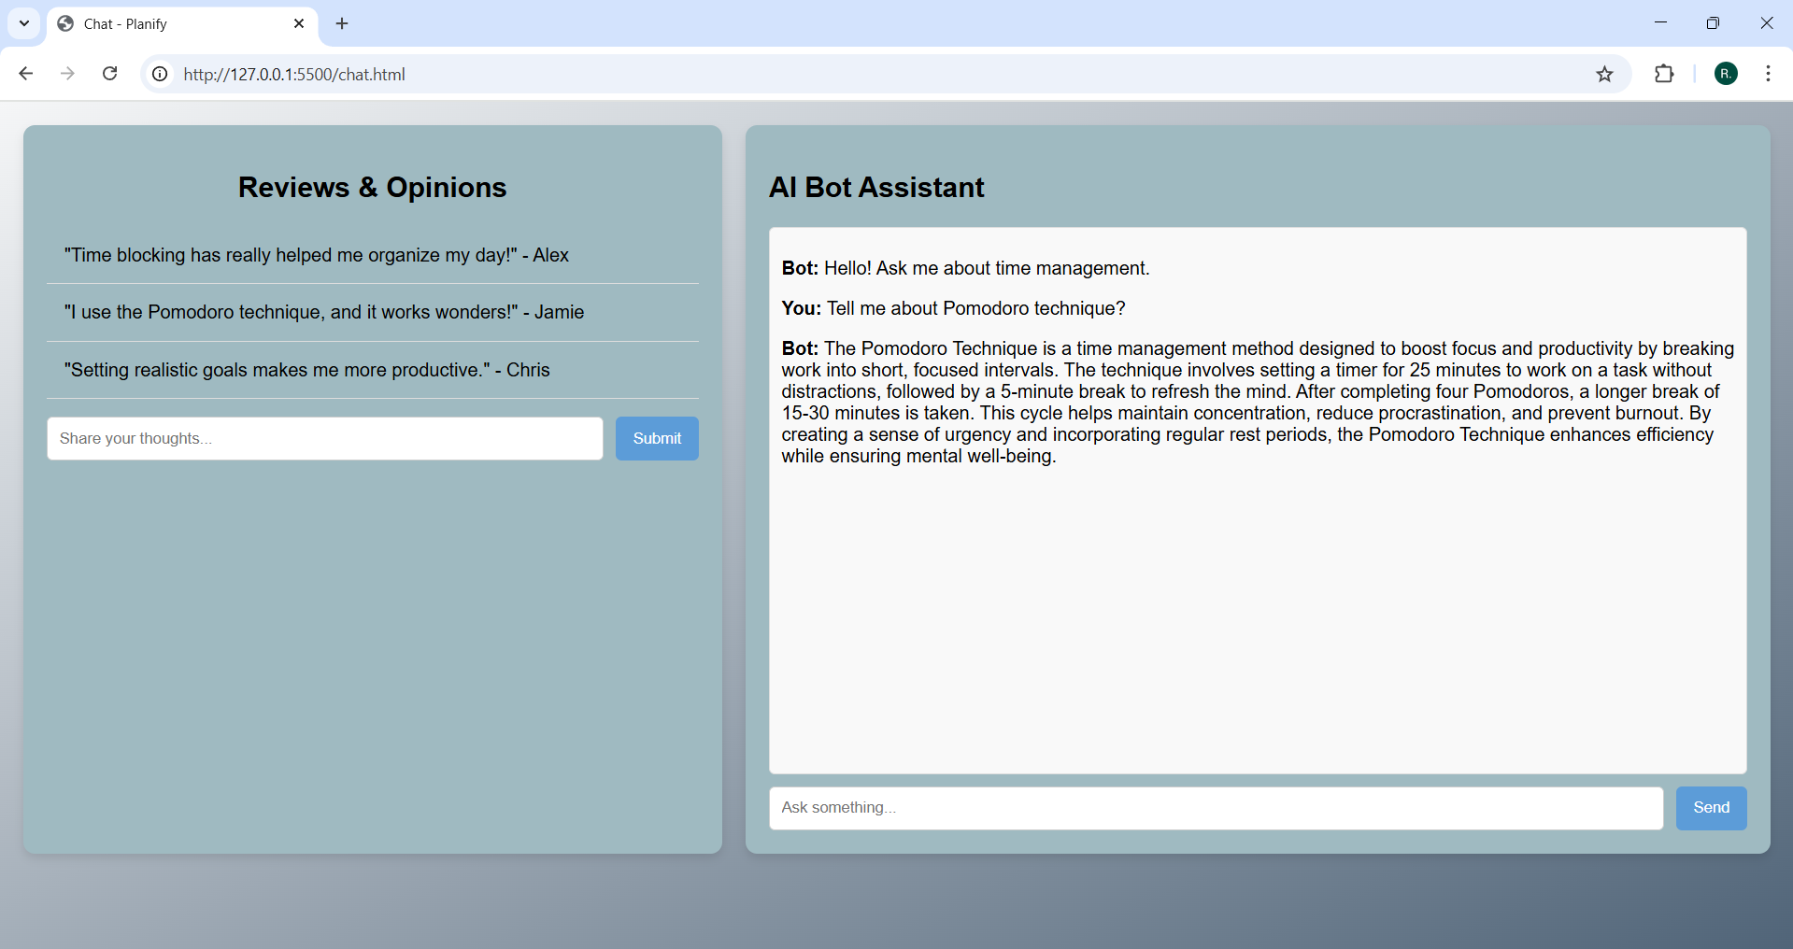

Slide 23


THANK YOU !!

